Slide 1

Money and Tasks Manager Software
Dept. of Computer Science and Engineering
MD. ATIK ID: 222311007 B.Sc. in CSE Varendra University

Slide 2
Contents
Introduction (Slide 1)
Contents (Slide 2)
Works of this Software (Slide 3)
Software Flow Chart (Slide 4)
How to use this software (Slide 5 to 11)
Adding GUI to this software (Slide 12)
Questions and Answer (Slide 13)
In my previous presentation, I have told about my software. Today I will told, How a user can use this software and get benefited…
2 out of 14

Slide 3


Works of this Software
Money and tasks manager software is a software that combines the functionalities of both money and task manager software where users can manage their financial activities, such as budgeting, expense tracking, and bill payments, as well as their tasks and projects, all in one place.
3 out of 14

Slide 4
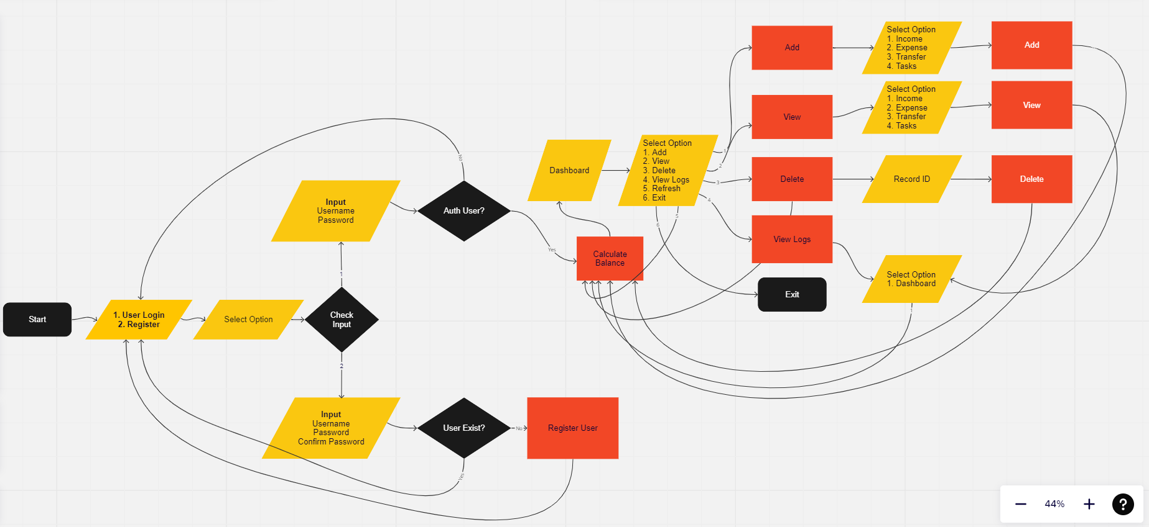
Software Flow Chart
4 out of 14

Slide 5
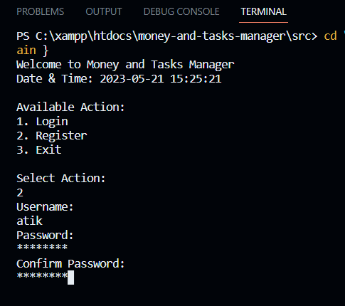
Register a User
5 out of 14

Slide 6
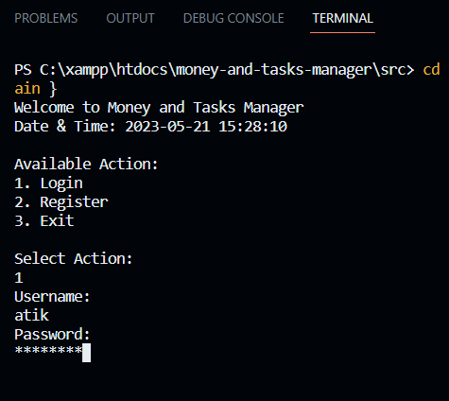
Login a User
6 out of 14

Slide 7
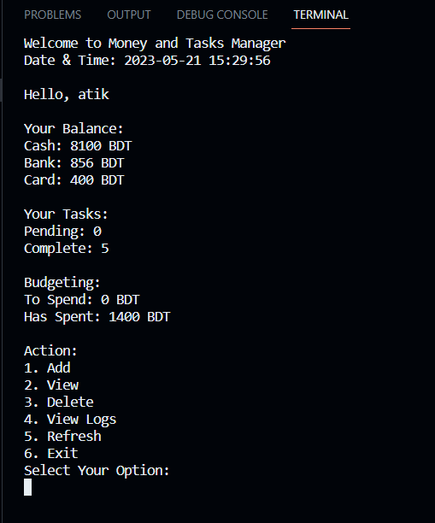
Dashboard
7 out of 14

Slide 8
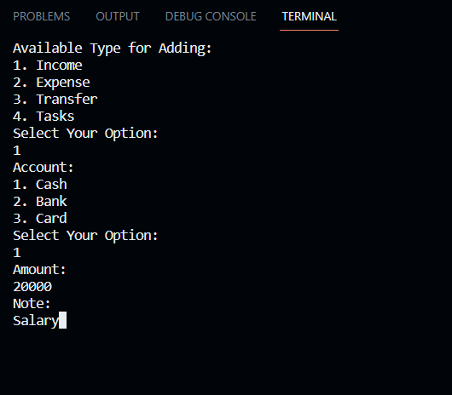
Adding a Record
8 out of 14

Slide 9
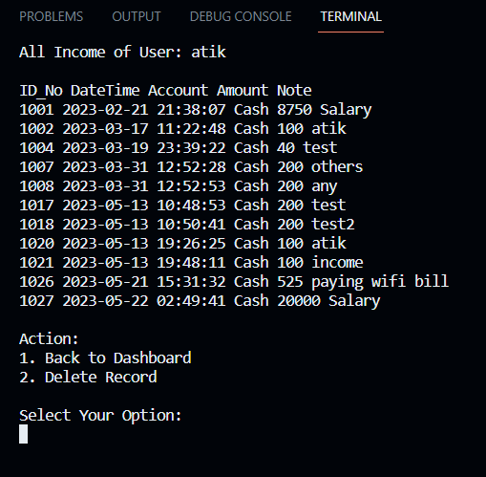
View Records
9 out of 14

Slide 10
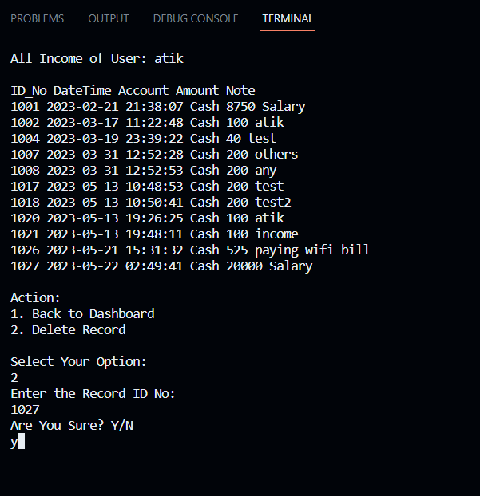
Delete a Record
10 out of 14

Slide 11
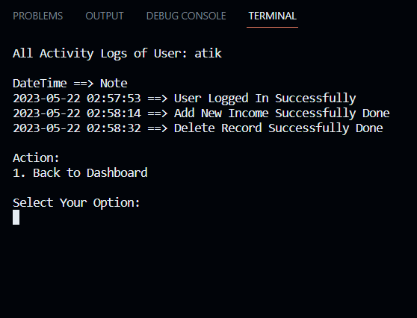
View Activity Logs
11 out of 14

Slide 12
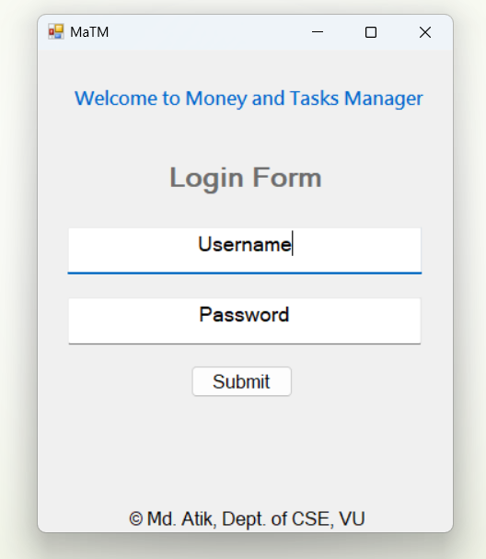
Currently Adding Graphical User Interface to this Software
12 out of 14

Slide 13
Questions and Answer
Feel free to ask
13 out of 14

Slide 14

Thanks for your patience and listening to me.

